Slide 1
TablePlease
By: Arshiya, Puneetha, Mohga, Pari, Parsa, and Neha

Slide 2


TablePlease App Background
One stop app for reservations:
Check in at restaurant
Notified when table is ready
Check restaurant wait times
Order ahead
Bookings for events
Domain:
Restaurant Industry
Customer Service
Necessity - why this app is important:
Currently no well known app exists that handles all reservation related tasks in one place
Eliminates the need to check with individual restaurants regarding availability
Allows customers to save time and energy when it comes to reservations and bookings.
Notes:
https://www.flaticon.com/free-icon/notification_2343772
https://www.flaticon.com/free-icons/restaurant

Slide 3

Appealing Features of our Design
Consistent aesthetic and formatting
Relevant graphics and imagery
Access other pages easily (Back button on every screen)
Follows accessibility design standards (Large font size)
Extensive filtering system
Can be used by both restaurant owners and customers of the restaurant
Personalized profiles
Notes:
https://www.flaticon.com/free-icon/smartphone_186239?term=phone+app&page=1&position=1&origin=search&related_id=186239

Slide 4
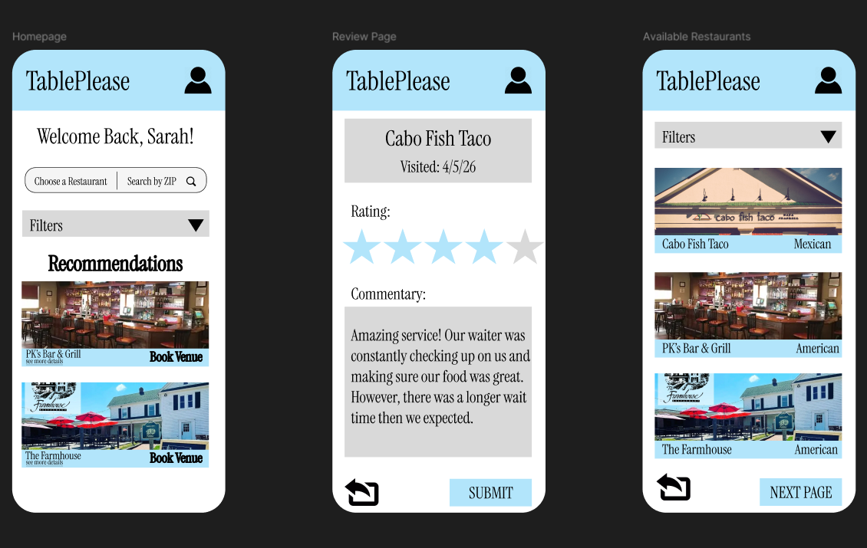
Mock UIs
Company Name
Meet the team
Year/Quarter/Month
Full Name
Title
Full Name
Title
Full Name
Title

Slide 5
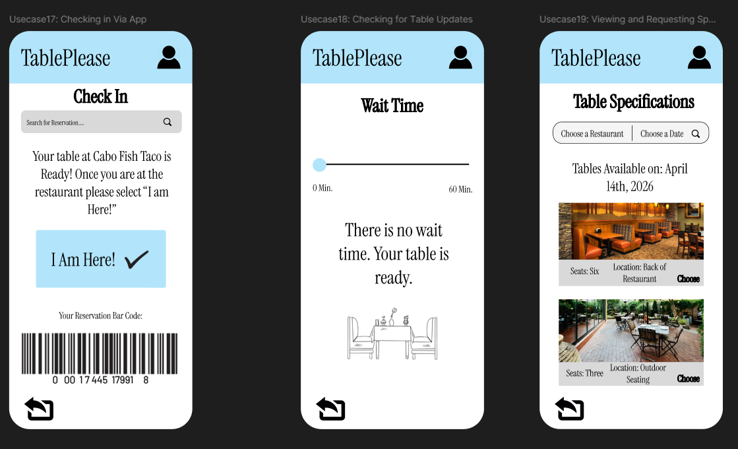
Company Name
Meet the team
Year/Quarter/Month
Full Name
Title
Full Name
Title
Full Name
Title

Slide 6
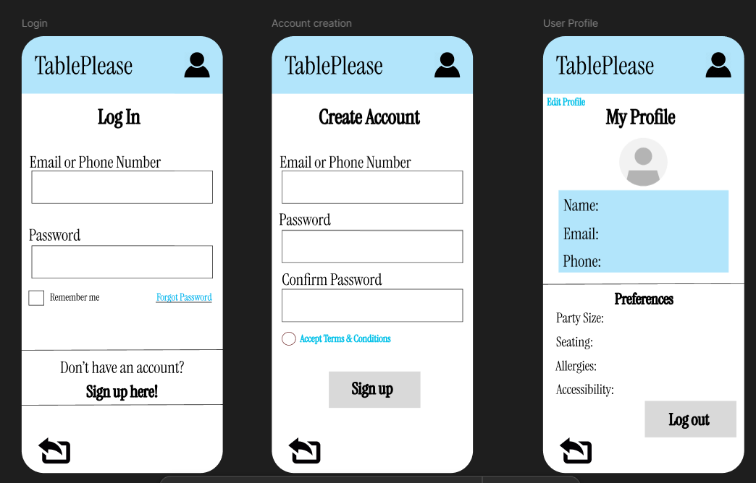
Company Name
Meet the team
Year/Quarter/Month
Full Name
Title
Full Name
Title
Full Name
Title

Slide 7
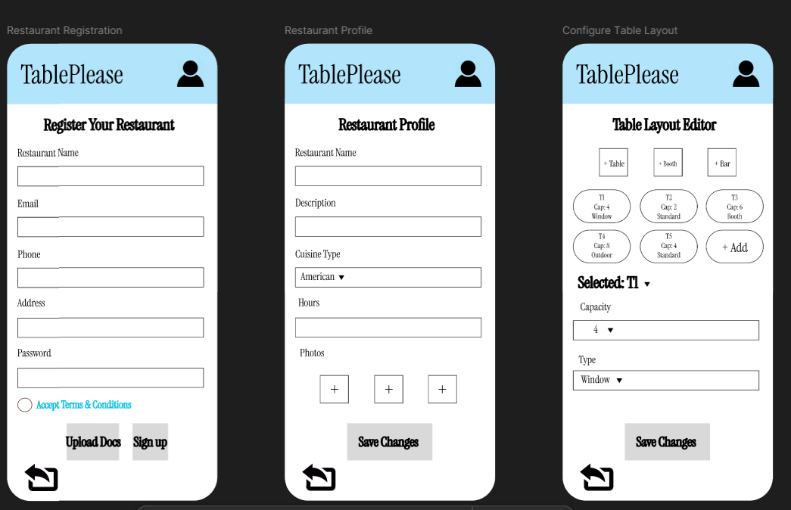
Company Name
Meet the team
Year/Quarter/Month
Full Name
Title
Full Name
Title
Full Name
Title

Slide 8
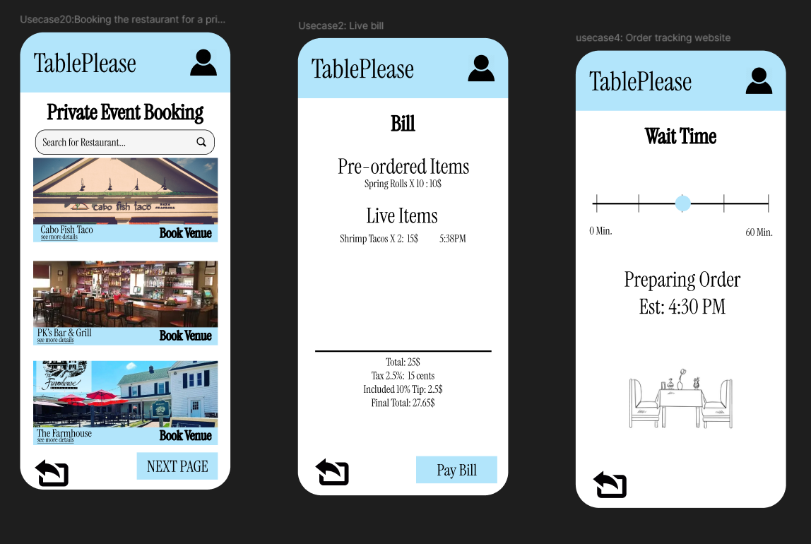
Company Name
Meet the team
Year/Quarter/Month
Full Name
Title
Full Name
Title
Full Name
Title

Slide 9
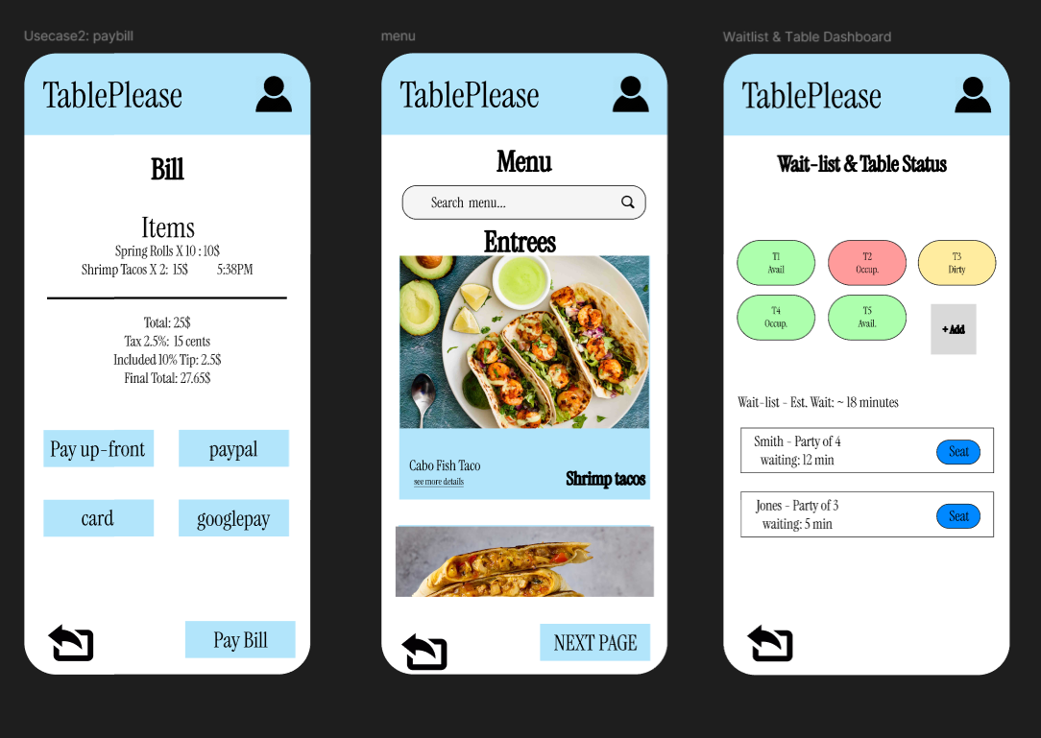
Company Name
Meet the team
Year/Quarter/Month
Full Name
Title
Full Name
Title
Full Name
Title

Slide 10
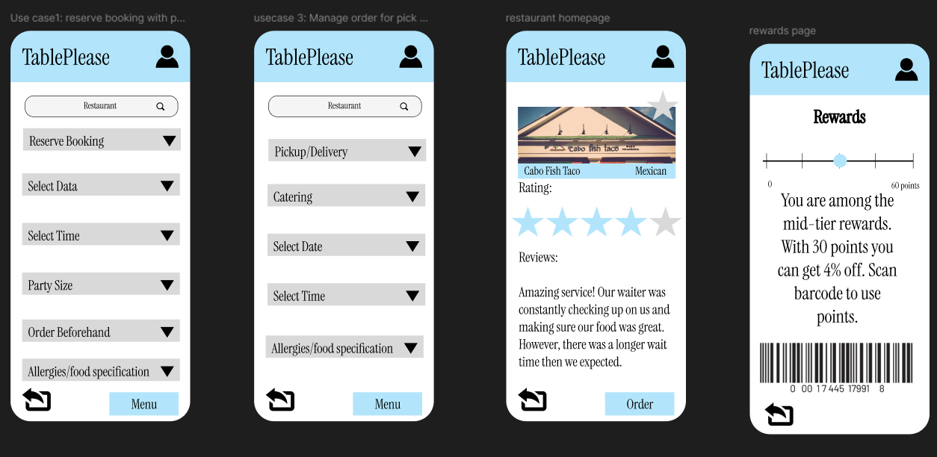
Company Name
Meet the team
Year/Quarter/Month
Full Name
Title
Full Name
Title
Full Name
Title

Slide 11

Major Challenges We Faced
Design:
Creating an app that doesn’t overwhelm the users with numerous features.
Designing an app that can be used by various groups of individuals.
Ensuring the design of the app is intuitive for users and is consistent.
Having all of our functionalities in their designated places.
Functionality:
Having each individual feature be easy for users to use.
Ensuring that features aren’t repetitive and that they add to the usability of the app.
Individual:
Integrating all of our ideas and functionalities to form one cohesive design.
Finding adequate time for everyone to work together.
Notes:
https://www.flaticon.com/free-icons/issue

Slide 12
Strategies We Used to Overcome These Challenges
Design:
Designing the app layout by drawing a singular basic wireframe and using it to create the other mock UIs.
Keeping a simple and consistent design layout for every page using the same font and coloring.
Functionality:
Starting with the essential features first (check-in, waitlist, reservations).
Adding the extra features such as reviews and ratings after.
Organizing the app’s structure based on how consumers will interact with it and including back buttons on every page.
Individual:
Helping each other to integrate ideas as a group to prevent any disconnect or incohesion in the design.
Meeting weekly to report on work done to ensure we stay on schedule.

Slide 13

Lessons Learned
Design:
Keep the design simple
Keeping the design simple and cohesive allows for easy navigation
Design for Everyone
accessibility and clarity benefits everyone so that everyone can understand what they are looking at
Functionality:
Fewer features done well beats many features done poorly
Designing core functions first (check-in, waitlist, reservations) gives us a clear foundation on app structure
Adding every idea we had could create a cluttered, confusing interface
Individual:
Communicate well and often with your team
Communicating often about what each member will accomplish allows for a cohesive effort towards completing assignments and creating good design
Notes:
https://www.flaticon.com/free-icon/lessons_11445797?term=lessons+learned&page=1&position=7&origin=search&related_id=11445797

Slide 14

Secrets for Success
Keep the user in mind when creating UI designs
Try to design the app based off of a users perspective
Communicate with your team members regarding your design ideas, implementation plans, and desired functionalities
Ensures there is no repetition and design is cohesive
If possible, ask those who are not familiar with the application to review the design
This is so that you can get an outside, objective, perspective
Do not stick to previous implementation decisions that no longer seem effective
Notes:
https://www.flaticon.com/free-icon/success_1628526?term=success&page=1&position=5&origin=search&related_id=1628526

Slide 15
Thank you

